Slide 1
Cse2037lab task1, nov 10th wednesday
Define a global array of decimal numbers including 01,02,03,04,05,06,07,08,09,10,11,12,13,14,15,16
Use 8 bits for each element.
Within main loop, utilizing a pointer and memory locations;
A) print odd numbers
B) print even numbers

Slide 2
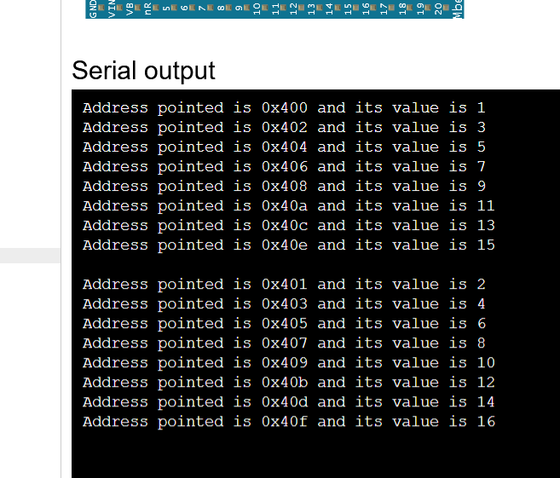

Slide 3
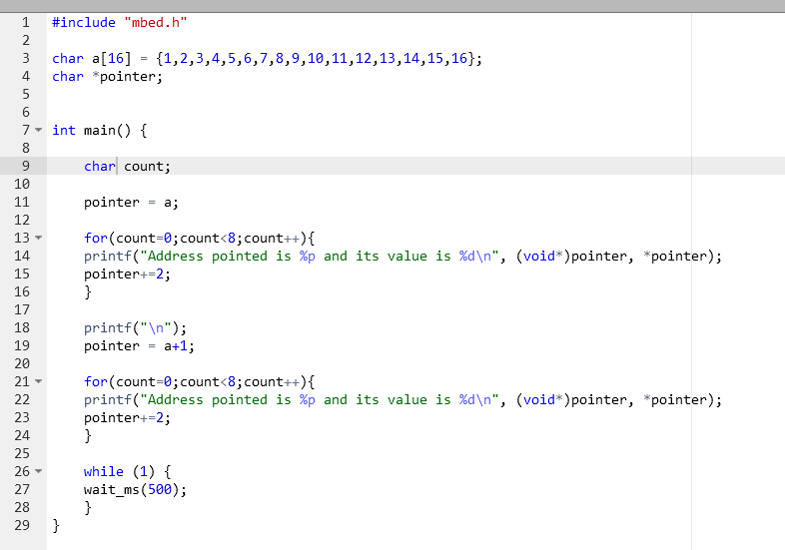

Slide 4
Cse2037lab task2, nov 11th thursday
Define an array of decimal numbers including 1,2,3,4,5,6,7,8,9,10,11,12,13,14,15,16,17,18,19,20,21,22…
Within main loop, utilizing a pointer to find memory locations and the values written on those locations;
A) print odd numbers, their adresses and also their cumulative summation
B) print even numbers, their adresses and also their cumulative summation

Slide 5
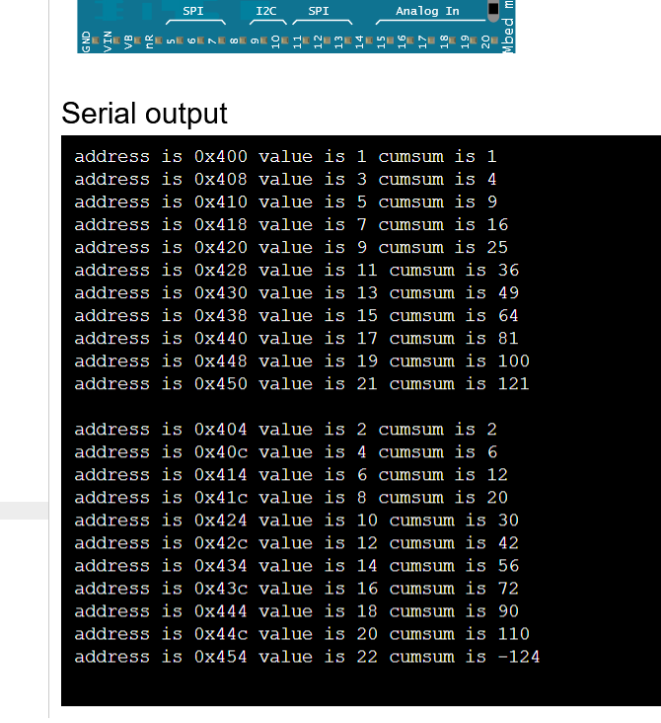

Slide 6
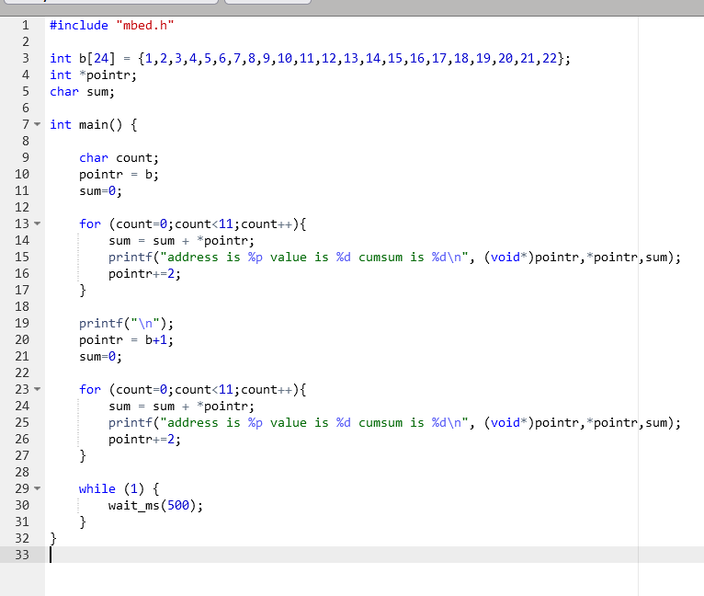

Slide 7
Cse2037lab task3, nov 17th wednesday
Define an array including, 1.05,2.15,3.25,4.35,5.45,6.55,7.65,8.75,9.85,10.95
Use 32 bit slots for each element beginning from 0x400
Within main loop, utilizing a pointer to find memory locations and the values written on those locations;
Print the adresses, values and their cumulative summation at each step.

Slide 8
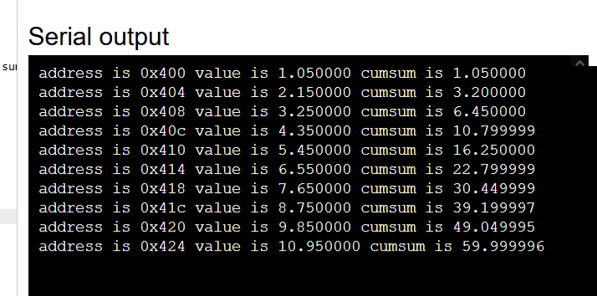

Slide 9
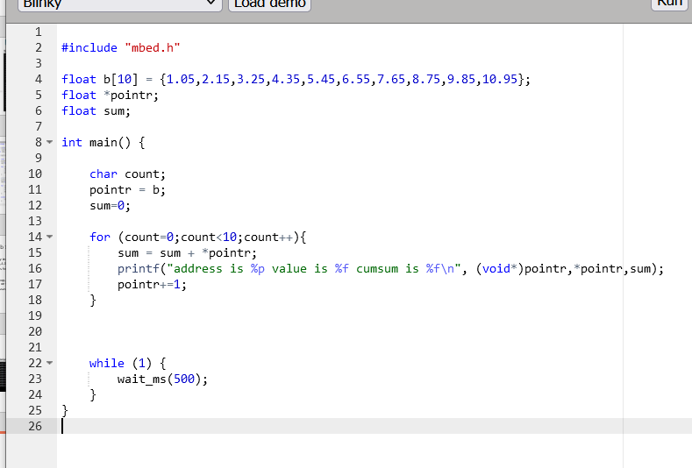

Slide 10
Cse2037lab task4, nov 18th thursday
Define the array below; 1.1,2.2,3.3,4.4,5.5,6.6,7.7,8.8,9.9,10.10,11.11,12.12
Memory locations should begin from 0x400
Use a pointer to find memory locations and the values written on those locations.
Print the adresses, values and their fractions at each step.

Slide 11
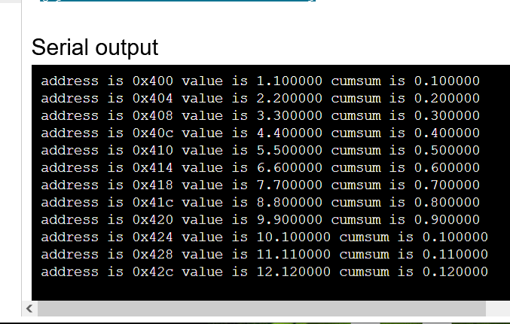

Slide 12
